Slide 1
{abstract}
Command
+ execute() {abstract}
Contains
Task
TaskList
+ categoryCounter(n: LocalDate): int
- date: ArrayList<LocalDate>
*
1
+ getDate(): ArrayList<LocalDate>
CalendarCommand
- totalDays: int
- totalWeeks: int
- startingDay: int
- checkMonth: int
- currentYear: int
GenerateCalendar
+ execute( ):
- setNumber(n: int)
+ CaldendarCommand(month: int)
Generate
- totalDays: int
- totalWeeks: int
- startingDay: int
- currentMonth: int
- currentYear: int
Check details
+ print(): String
- printLine(): String
- printFirstRow(): String
- printRow(): String
- getDailyTask(): String
- printHeader(): String
CalendarParser
- getFirstDay(): int
- getTotalWeeks(): int
- getTotalDays(): int
+ getMonth(): int
+ getYear() : int
+ convertToDate(n: String): LocalDate

Slide 2
:CalendarCommand
execute()
:CalendarParser
CalendarParser()
getMonth()
ref get details for requested month
:GenerateCalendar
GenerateCalendar()
:TaskList
print()
ref Format calendar headers
printFirstRow()
categoryCounter()
Number of tasks
printLine()
loop [ remaining weeks in month]
printRow()
categoryCounter()
Number of tasks
printLine()
CommandResult
Formatted Calendar

Slide 3
sd format calendar heaers
:GenerateCalendar
printLine()
printHeader()
printLine()

Slide 4
sd get details for requested month
:CalendarCommand
:CalendarParser
CalendarParser()
getMonth()
getFirstDay()
getTotalDays()
getTotalWeeks()
getYear()

Slide 5
Common
Exceptions
UI
Calendar
Command
Main
Task
Parser
Storage
Local storage
*Arrow heads represents possible flow of execution of components
** Dashed body arrows represents being accessible by all components
Notes:
Main
UI
Storage
Parser
Command
Common
Tasklist
Task
Calendar
Exception

Slide 6
ExitCommand
Display result of command
CommandResult
User issued command
Main
{abstract}
Command
1
Send feedback for printing
Ui
showResultToUser(CommandResult)
Notes:
Main
UI
Storage
Parser
Command
Common
Tasklist
Task
Calendar
Exception

Slide 7
TaskList
1
Contains Task
*
{Abstract}
Task
~ title: String
~ description: String
~ reminder: String
~ category: String
~ time: ArrayList<LocalTime>
~ date: ArrayList<LocalDate>
~ location: ArrayList<String>
Class
TaskNonClass
Notes:
Main
UI
Storage
Parser
Command
Common
Tasklist
Task
Calendar
Exception

Slide 8
Task
*
1
TaskList
GenerateCalendar
CalendarParser
CalendarCommand
User issued command
Main
{abstract}
Command
Notes:
Main
UI
Storage
Parser
Command
Common
Tasklist
Task
Calendar
Exception

Slide 9
Task
TaskList
GenerateCalendar
CalendarParser
Display result of command
CommandResult
CalendarCommand
User issued command
Main
{abstract}
Command
1
Send feedback for printing
Ui
showResultToUser(CommandResult)
Notes:
Main
UI
Storage
Parser
Command
Common
Tasklist
Task
Calendar
Exception

Slide 10
Command{abstract}
uses
UI
+execute(){abstract}
+showCategory(arr[string])
+showTask(arr[int])
ListCommand
AddCommmand
+ execute()
- getList (listTaskIndex : ArrayList<Integer>)
- getListByCategory (listTaskIndex : ArrayList<Integer>, category: String)
+execute()
1
1
TaskList
-categoryMap: Map(string, arr[int])
-tasks: ArrayList(Task)
1
{Abstract}
Task
*
+returnCategoryTask(category:String):arr[int]
+returnAllCategory():arr[string]
+getTask(taskIndex: Integer): Task
~ category: String
+ getCategory():string
+ getTask():string
Class
TaskNonClass

Slide 11
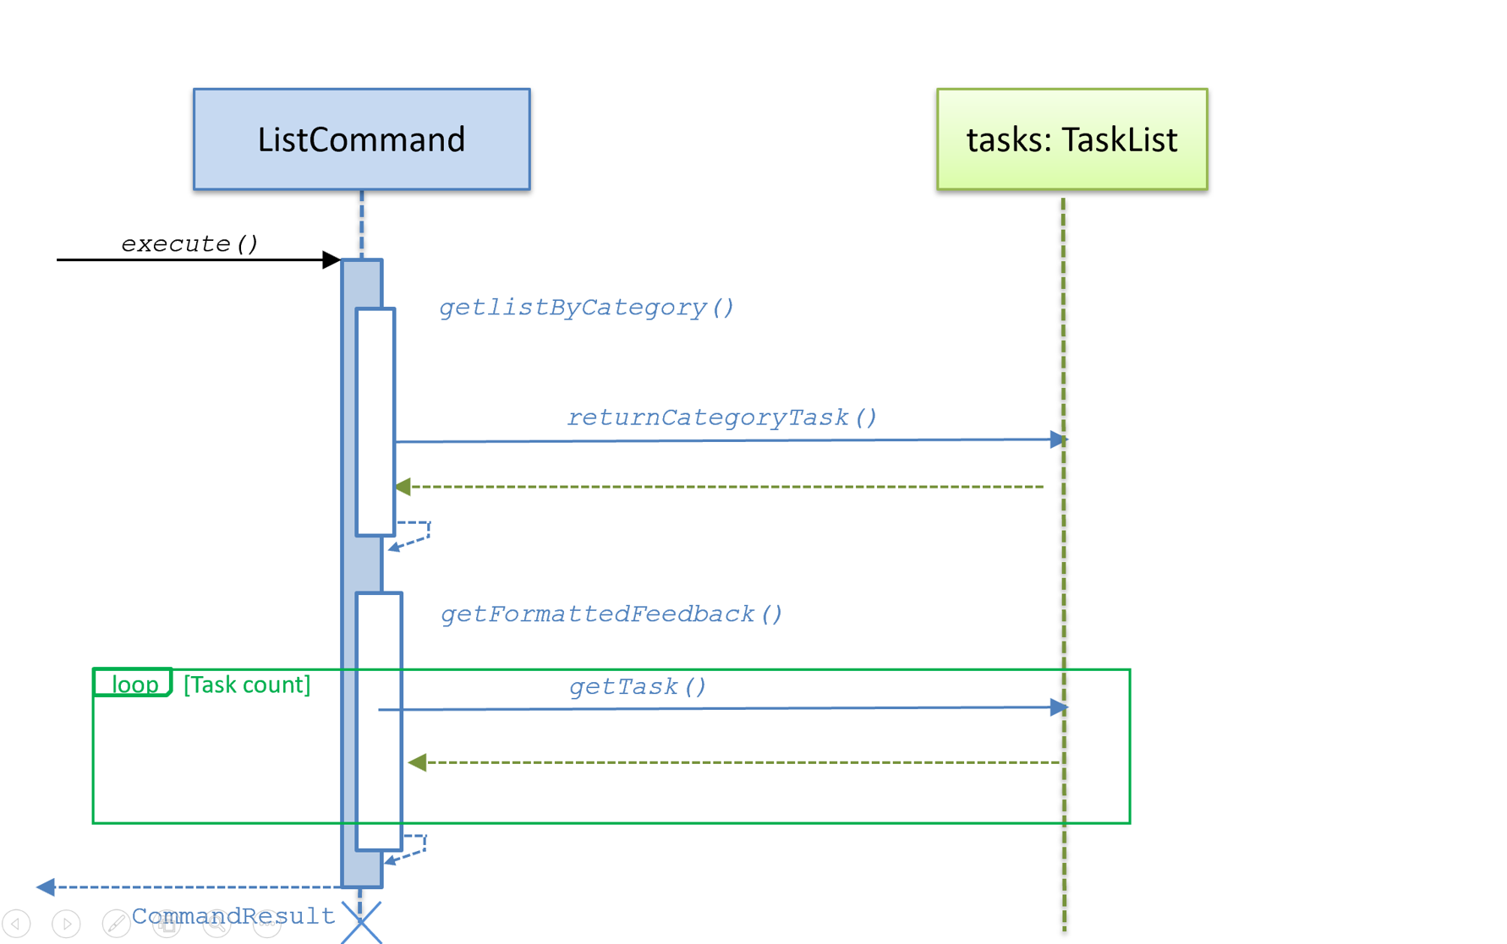

Slide 12
Command{abstract}
Storage
{Abstract}Task
~ taskList : TaskList
~ storage : Storage
~ ui : Ui
- gson: Gson
~ title: String
~ description: String
~ reminder: String
~ category: String
~ time: ArrayList<LocalTime>
~ date: ArrayList<LocalDate>
~ location: ArrayList<String>
+ overwriteFile(taskList : ArrayList<Task>)
+ getTitle (userInput : String) : String
+ getDescription (userInput : String) : String
+ getDate (userInput : String) : String
+ getReminder(userInput : String) : String
+ getTime (userInput : String) : String
+ getLocation (userInput : String) : String
+ getCategory (userInput : String) : String
~ checkDateTimeFormate (date: String, time: String)
~ hasWrongDelimiterPattern (input : String) : Boolean
- findField (userInput : String, fromIndex : Integer) : String
+ execute() : CommandResult{abstarct}
*
1
TaskList
-tasks: ArrayList(Task)
+addTask (task : Task)
+Task(title:String, description:String,time:String,location:String,reminder:String,category;String)
~ hasInput(input:String)
+setlocation(location:String)
+setTime(time:String)
+setDate(dateInput:String){abstract}
+ toString() : String
Overwrite Storage
Add tasks
AddCommmand
- userInput : String
+ AddCommand (userInput : string)
+ execute() : CommandResult
- formatFeedback (Task task) : String
CommandResult
- feedback : String
Return CommandResult
Class
TaskNonClass
+ getFeedback() : String
+ CommandResult (feedback : String)
+setDate(dateInput:String)
+toString():String
+setDate(dateInput:String)
+toString():String

Slide 13
AddCommand
tasks: TaskList
: Storage
execute()
Get all field
checkDateTimeFormat(date,time)
alt
[inputCategory != CLASS]
addTask(task)
[inputCategory == CLASS]
addTask(class)
getList()
ArrayList<Task>
overwriteFile(ArrayList<Task>)
CommandResult

Slide 14
overwrites with
DoneCommand
EditCommand
overwrites with
loads from
Storage
Main
1
- gson: Gson
AddCommand
+ overwriteFile (list: TaskList)
+ loadFromFile (list: TaskList)
overwrites with
DeleteCommand
overwrites with

Slide 15
:AddCommand
:TaskList
:Storage
execute()
add()
overwriteFile(TaskList)
CommandResult

Slide 16
Sequence diagrams [example]
:TextUI
:MSLogic
<<class>> :Logger
Player
loop [until won|lost]
mark x y
markCellAt(x,y)
log()
getGameState()
Show updated minefield
gameState

Slide 17
Class diagrams
Class name
attributes
methods
association
multiplicity of A
association label
role of B
Class A
Class B
role of A
multiplicity of B
Superclass
<<enumeration>> EnumerationName
inheritance
VALUE_1
VALUE_2
enumerations
Subclass 1
Subclass 2
composition
aggregation
Whole
Part
Container
Item

Slide 18
Class name
abstract/ static
visibility name : type multiplicity = default-value
{abstract} AbstractClass
visibility name (parameter-list) : return-type
classLevelAttribute
interfaces
abstractOperation {abstract}
classLevelOperation
<<interface>> Interface name
navigability
Class 1
Class 2
Class A
Class B
Association class
Class C
dependency
Class A
Class B
Class A
Class B

Slide 19
Class diagrams [example]
< adjacent to
3..8
neighbor
Minesweeper
0..1
Minefield
100
Cell
3..8
played on >
<<enumeration>> AdjacentMines
MinedCell
MineFreeCell
0,1,2,3,4,5,6,7,8
digit: AdjacentMines
1
Mine
Table
- number: Integer
- chairs: Chair [0..6] = null
+ totalTables: Integer
Customer
*
+ getNumber( ): Integer
+ setNumber(n: Integer)
+ getTotal( ): Integer
+ Table(n: Integer, p: Integer)
Reservation
LoyaltyProgram
- startTime
- endTime

Slide 20
Object diagrams
Object Name : Class Name
attributes
[example]
supervises
Jean:Student
Lee:Professor
name = “L. John”
Jon:Student
supervises
:Professor
:Student
:Admin
looked after by >
< looked after by

Slide 21
Sequence diagrams
alt [condition]
<<class>> :Logger
[condition]
name:Class1
[else]
class-level method
loop [condition]
create
:Class2
opt [condition]
self-call
message
return value
par

Slide 22
Notes and constraints
Note text
{constraint}
Note text
{constraint}
[examples]
This association may change later
{total >= 0}

